Slide 1
Symbolism
Review and Practice

Slide 2
What’s the symbolism?
Let’s look at some images and practice.

Slide 6
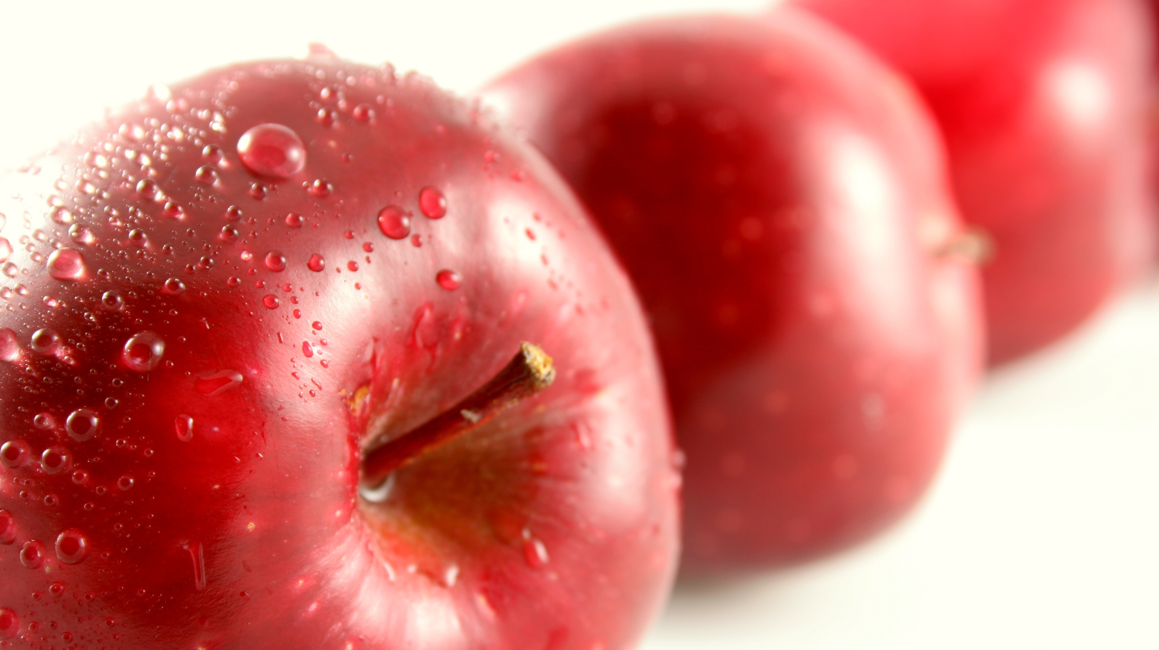

Slide 7
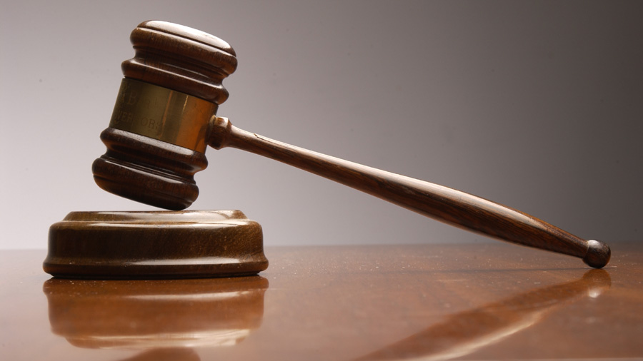

Slide 8
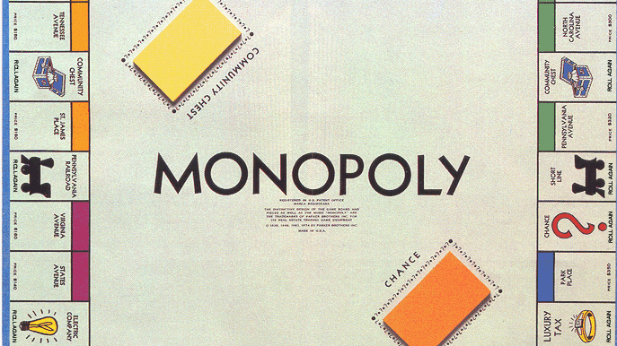

Slide 9
CONNECTING to the PLAY Why might a rubber duckie be a good symbol to represent Mary Warren? Discuss!

Slide 10
Model Slide 1: Select a character and a symbol (click on “insert” at top bar, then click on “icons”)
Character=Mary Warren
Symbol=

Slide 11
Model Slide 2: Context/Evidence/Analysis
CONTEXT What’s going on at the point in the text that the evidence appears? 1 sentence only! | EVIDENCE Cite correctly! | EXPLANATION/ANALYSIS Avoid phrases like “this proves that/this shows that…” Avoid personal pronouns 3-5 sentences
Mary is frustrated as Abby and the other girls claim to see a bird and then mimic Mary’s actions and words in the court, leading Mary to accuse John. | “screaming at [John]: “I go your way no more…Abby, Abby, I’ll never hurt you more!” (Miller 119). NOTE: John is in brackets because the text reads that Mary is, “screaming at him.” By changing “him” to “John” and bracketing it, the writer indicates that he/she is changing a piece of the text for clarity. | Although Mary originally goes to court with John to expose Abby as a fraud, she cracks under the intimidation from her friends. By turning on John and falsely naming him as another Salem witch, Mary reveals how very much like a rubber duckie she is. She is very soft and moldable and when she’s squeezed too tightly—or feels the weight of peer pressure—she quacks, or yells out in exasperation.

Slide 12
Your task
Create 2 slides, as modeled with Mary/duckie example
Slide 1: Indicate your character choice and symbol choice (to select a symbol, you must go the top bar, click on “Insert,” and then click on “Icons.”) Be original! (Example: do not choose books for Hale, or money for Parris, or a gavel/scales of justice for Danforth, or a snake for Putnam, or a wedding ring for Elizabeth/Abby…)
➔ When you think you have selected a character and
symbol, call me over to conference before moving on
to slide 2.
Slide 2: Set context, provide evidence, explain how the evidence links the symbol to the character.
When you are done, delete everything in this powerpoint except for your two slides, and email the work as an attachment to me and your partner.

Slide 13
Student Slide 1
Character=
Symbol=

Slide 14
Student Slide 2
CONTEXT What’s going on at the point in the text that the evidence appears? 1 sentence only! | EVIDENCE Cite correctly! | EXPLANATION/ANALYSIS Avoid phrases like “this proves that/this shows that…” Avoid personal pronouns

